Slide 1
Honeypot group KryptoBoiZ

Slide 2
Table of Contents
Current Deliverables
Future Sprint
Questions

Slide 3
Research Document
Determined Agreements and requirements with client
Updated Network Diagram
Specified Research Questions
Initial Research done on first few subquestions

Slide 4
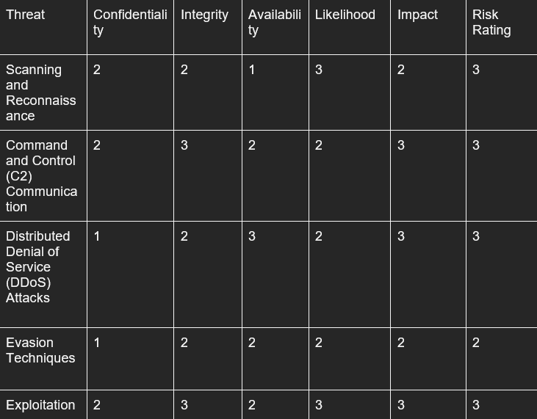
NIST-Requirements
Determined security requirements
Decided on Software/Operating systems to be used
Decided on logging and network tools to be used (Wazuh)
Listed and indexed threats using a CIA table

Slide 5
Vulnerability Report
VLan explanation
Services with their corresponding vulnerability explanation and argumentation

Slide 6
Started Implementation
Started implementing the fe/be.
Currently finished features
User authentication & authorization + corresponding vulnerability in the login/register.
FE template laid out.
Consulted with raoul about using an SQL parser/ dumbed down version of a parser to give them false positives, to find the difference between SQLMap and a real SQLi

Slide 7
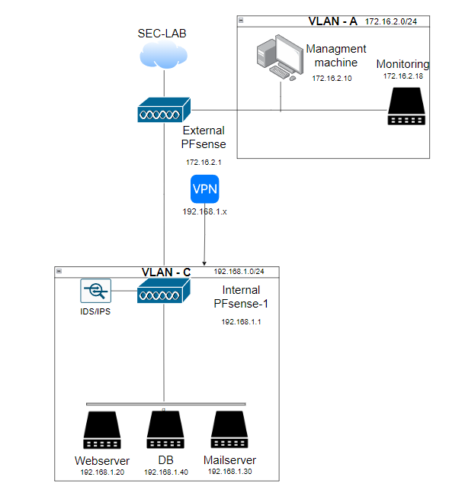
Updated Network
After discussing with the client and coach the following changes were made
2 vlans instead of 3
VPN connection into the honeypot for management.
PFsense being forwarded to the management machine for managment
Firewall rules in place blocking connections towards VLAN-A from VLAN-C but VLAN-A is able to talk to VLAN-C

Slide 8
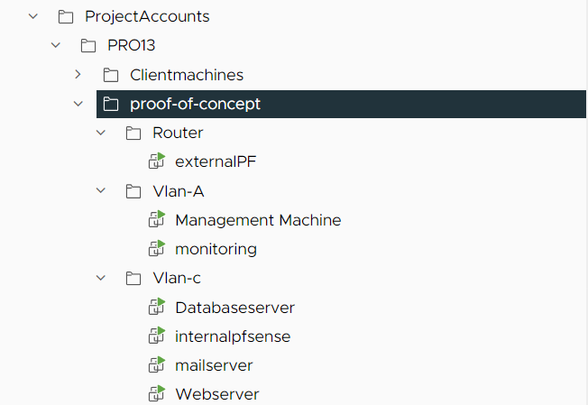
Group environment
Proof of concept in progress,
missing the monitoring side and cowrie since that was discussed last week and left not enough time for research/implementation

Slide 9
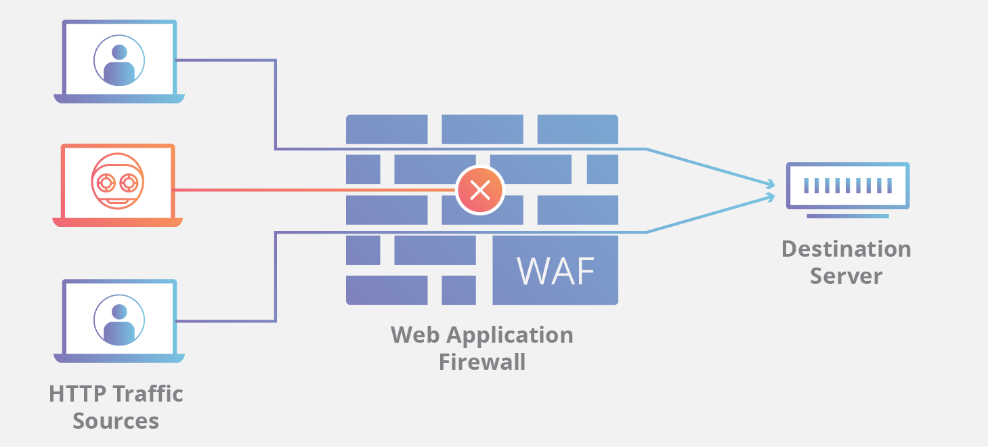
Future Sprint
Parser? + Web Application Firewall + BE api
Proof of concept network
Actual Implementation from design

Slide 10
Questions?

